Slide 1
DeepSched: A Deep Representation Of Scheduling
Policies For Heterogeneous Distributed Systems
Team #10
Mohamed Shawky Zaky, Sec: 2, BN: 16
Remonda Talaat, Sec: 1, BN: 20
Mahmoud Osman Adas, Sec: 2, BN: 21
Evram Youssef, Sec: 1, BN: 9
DeepSched
Team 10

Slide 2
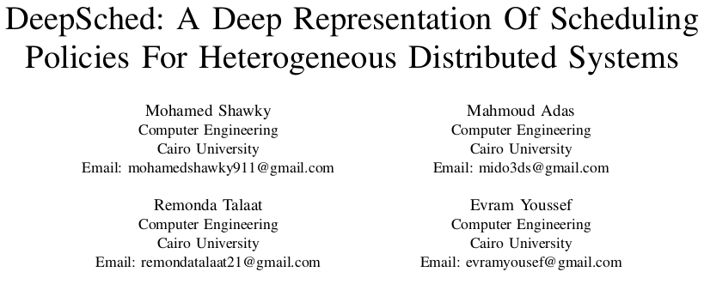

Demonstration Audio
DeepSched
Team 10

Slide 3

Introduction
Task scheduling is a very critical factor to the performance of all systems.
Heterogeneity of the systems adds extra layers of complexity to the scheduling problem.
Heterogeneous task scheduling is divided into Heuristic and Approximate methods.
DeepSched
Team 10

Slide 4
Introduction
We study the approximation of heuristic methods using predictive models, specifically neural networks.
We use HEFT as our heuristic baseline, genetic algorithms as our approximate baseline.
DeepSched
Team 10

Slide 5
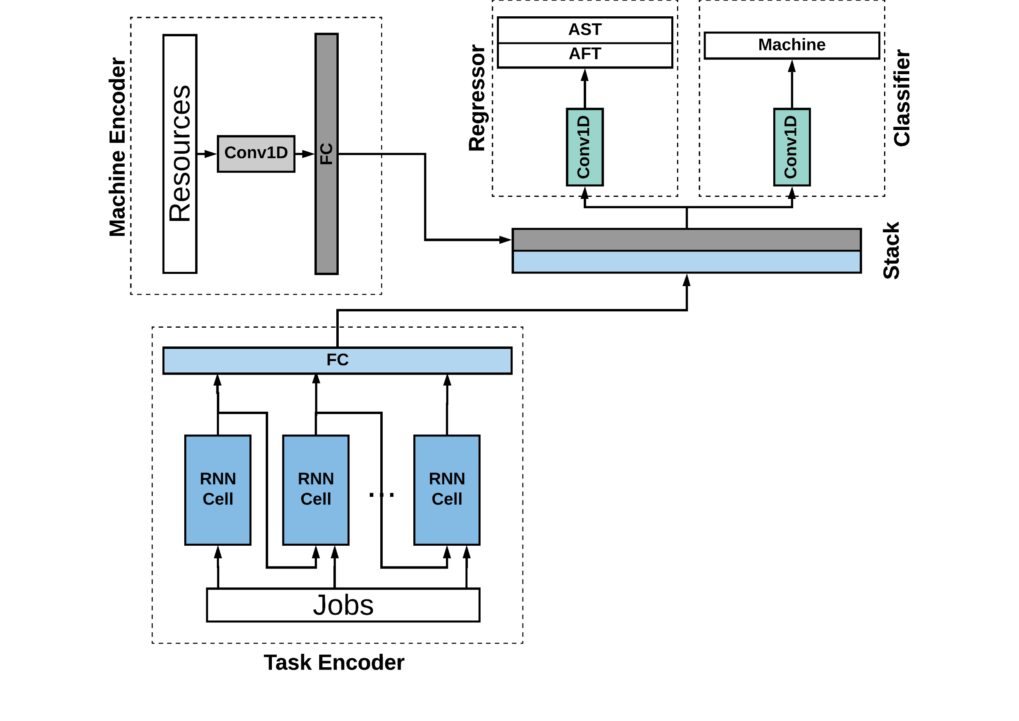
Proposed network
The network consists of 4 main blocks:
Task Encoder.
Machine Encoder.
Classification Module.
Regression Module.
The network dimensions are adjusted on the maximum number of tasks and resources.
Full network code is available at: https://github.com/DarkGeekMS/deepsched
DeepSched
Team 10

Slide 6
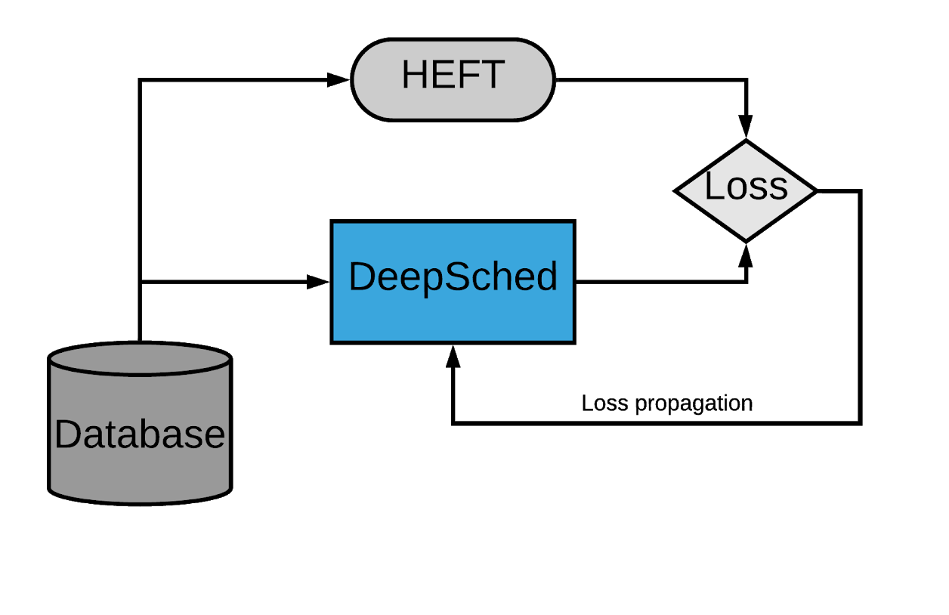
Training Framework
A database of tasks and resources is provided to both DeepSched network and HEFT.
The network is trained on the loss between its predicted schedules and the schedules produced by HEFT.
DeepSched
Team 10

Slide 7
Training Framework
The network loss is mainly composed of two parts:
Classification loss of the running machine for each task.
Regression loss for actual start and finish time of each task (to add some constraints on the loss function).
The summation of these two losses is used to train the network.
DeepSched
Team 10

Slide 8
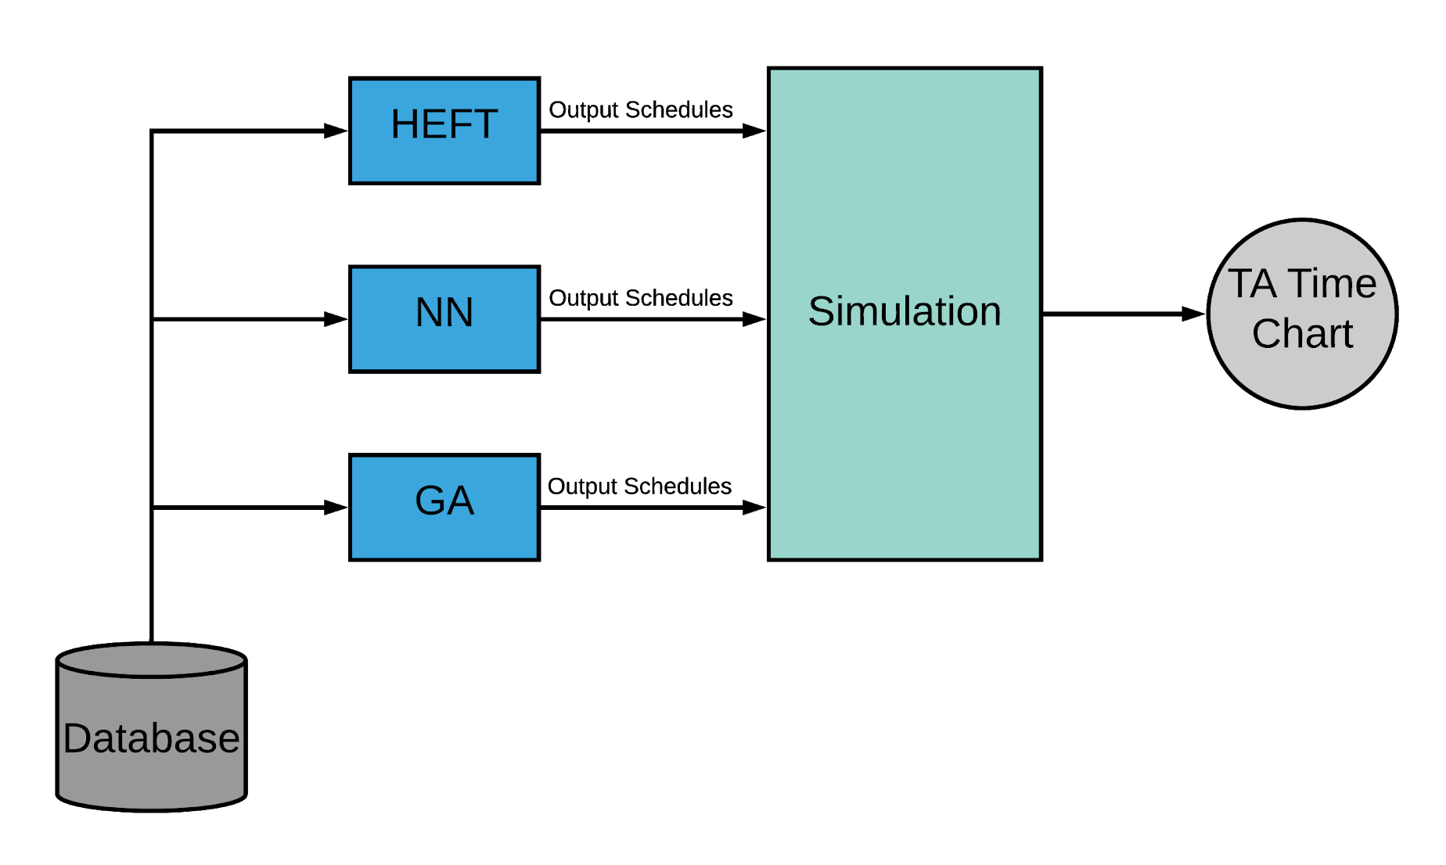
Evaluation Framework
A database of both seen and unseen data is provided to the three discussed methods.
The output schedules of the three methods are passed to a simulation stub that runs the schedules and calculates the average turnaround time.
This is repeated on multiple input sizes.
DeepSched
Team 10

Slide 9
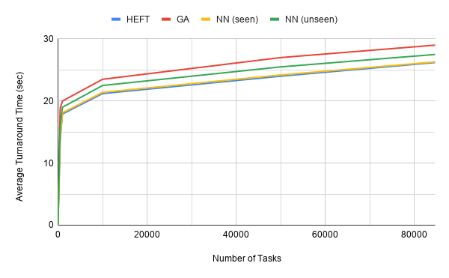
Results Discussion
Our results are divided into two parts:
Performance analysis:
The opposite graph shows the average turnaround time for different input sizes.
We can see that the network can offer the same performance as HEFT on seen data and slightly lower performance on unseen data. However, it still outperforms GA.
DeepSched
Team 10

Slide 10
Results Discussion
Our results are divided into two parts:
Time analysis:
We can see in the opposite table that the execution time of the network is constant over different input sizes, while the execution time of HEFT and GA grows rapidly.
Input Size | HEFT | GA | NN
486 | 31.5 | 67.5 | 0.125
10000 | 305.5 | 602.5 | 0.125
84654 | 670.0 | 3967.0 | 0.125
DeepSched
Team 10

Slide 11
Future work and limitations
This work can be improved in two possible ways:
Approximation of other scheduling algorithms, where we can go with some optimal algorithms.
Dealing with dynamic scenarios through online network optimization or reinforcement learning environments, because static scenarios and maximum predefined input size are the main drawbacks of the proposed method.
DeepSched
Team 10

